Slide 1
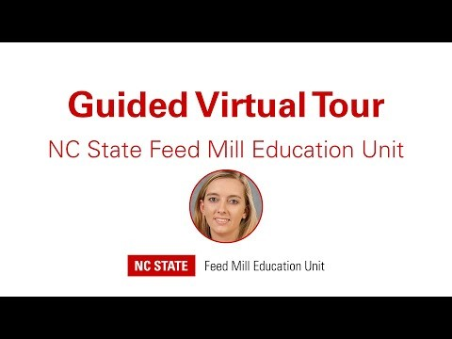
Virtual Feed Mill Tour
Watch the pre-recorded video together on Zoom
Write down any questions you have or send them in the chat!

Slide 3
Common ingredients in poultry diets
Major ingredients: Corn, soybean meal, wheat
Minor ingredients: Poultry meal, distillers’ dried grains (DDGS)
Micro ingredients: Vitamins, minerals, salt, limestone, sodium bicarbonate (anyone know what this is?), enzymes
Liquid ingredients: poultry or other animal fats, soybean oil

Slide 4
Human ingredients Poultry ingredients
Flour
Granulated sugar
Brown sugar
Baking soda
Salt
Egg
Butter
Chocolate chips
Vanilla Extract
Salt
Lysine
Methionine
Soybean meal
Black soldier fly larvae
Corn
Sodium bicarbonate
Soy oil
Trace mineral premix

Slide 5
Mini Cookie Mill Activity
Rules:
Do NOT eat raw dough or raw products – no matter how tempting it is!
Tie back long hair
Remove loose jewelry
Roll up long sleeves
Make sure there is nothing in the oven before turning it on
Use oven mitts to remove food from the oven
Turn off the oven when done baking
In the event of a fire, notify adult at home and call 911

Slide 6
Mini Cookie Mill Activity
Before we begin
Wash your hands for 20 seconds with soap and clean, running water
Prepare your work station
Visual inspection – remove any visible material
Wipe with cleaning solution
Wash hands after working with raw product, or after you touch your face or any other “dirty” surface

Slide 7
Mini Cookie Mill Activity
1. Preheat oven to 375 F
In the feed mill, we have to make sure the pellet mill is warmed up before we use it. Often, we will send some feed through the pellet mill to get it warmed up!
2. Combine flour, baking soda, and salt in a small bowl.
This is similar to the dry mixing step! The flour is the “major” ingredient and the baking soda and salt are the “micro” ingredients pre-measured like we would in the premix room!

Slide 8
Mini Cookie Mill Activity
3. Beat butter, granulated sugar, brown sugar and vanilla extract in a larger mixer bowl until creamy
4. Add egg, beating well after addition
5. Gradually beat in flour mixture.
How is this different from the feed-making process in the video?
6. Stir in chocolate chips using a spoon or spatula

Slide 9
Mini Cookie Mill Activity
7. Drop by rounded tablespoon onto ungreased baking sheets. You can use two spoons or a small scoop to avoid touching the raw dough!
8. Bake for 9-11 minutes or until golden brown.
This is similar to the pelleting process!

Slide 10
Discussion
While the cookies are baking, you will be put into your breakout rooms for group discussions (approx. 4 minutes). Use the following questions to help guide the discussion.
How is the process of making feed similar to baking cookies? How is it different?
How did you measure ingredients in the recipe? How do we measure ingredients in the feed mill? How are these processes different?
What types of major, minor, or micro ingredients are in poultry feed?
What types of ingredients might be in animal food and human food?
Do you have any questions about the feed-making process?

Slide 11
Discussion – least cost formulation
Recipe Ingredients | Cheapest ingredients we can find ($/recipe) | Cheapest ingredients we can find + GF Flour ($/recipe) | Cheapest ingredients we can find + 2x CC ($/recipe)
Flour | $0.10 | $0.67 | $0.10
Baking soda | $0.0030 | $0.0030 | $0.0030
Salt | $0.0044 | $0.0044 | $0.0044
Sugar | $0.08 | $0.08 | $0.08
Brown sugar | $0.12 | $0.12 | $0.12
Vanilla extract | $0.15 | $0.15 | $0.15
Chocolate chips | $1.40 | $1.40 | $2.80
Butter | $0.69 | $0.69 | $0.69
Eggs | $0.13 | $0.13 | $0.13
Total cost per recipe | $2.67 | $3.25 | $4.07
Cost per pound | $8.42 | $10.24 | $12.83
Cost per ton | $16,841.60 | $20,484.15 | $25,667.05

Slide 12
Mini Cookie Mill Activity
9. Cool on baking sheets for 2 minutes, then place on wire racks or plate to cool completely.
This is similar to the cooling process!
Great Job! Now it’s time to sit back and enjoy your snack! Don’t forget to turn the oven off when you’re done!

